Slide 1


LEO Satellites For
Time Synchronization
Workshop on Time Synchronization
May 12, 2022
Tyler Reid, CTO
Notes:
Thank you for the kind introduction and for the invitation to speak here today, it is an honour to be here with all of you.
Today, I’m excited to talk about commercial LEO PNT satellites and the potential benefits that can bring specifically to the timing world

Slide 2
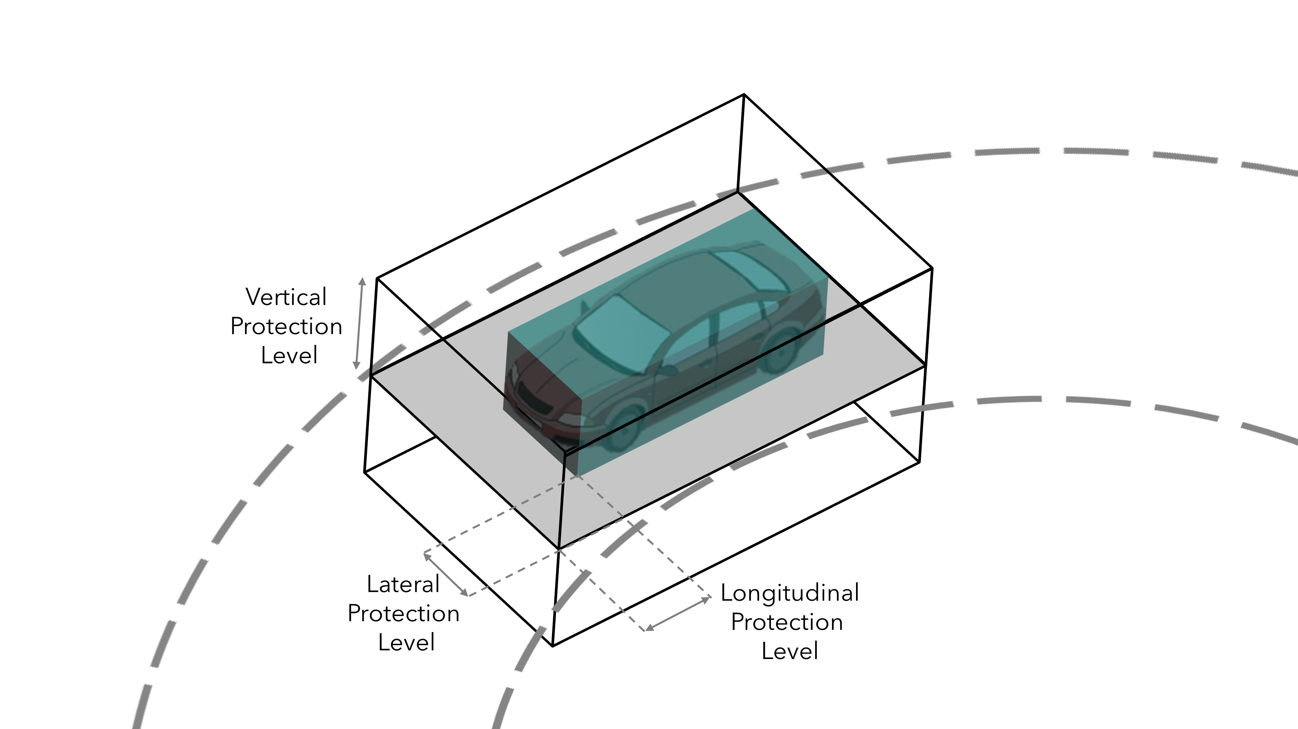

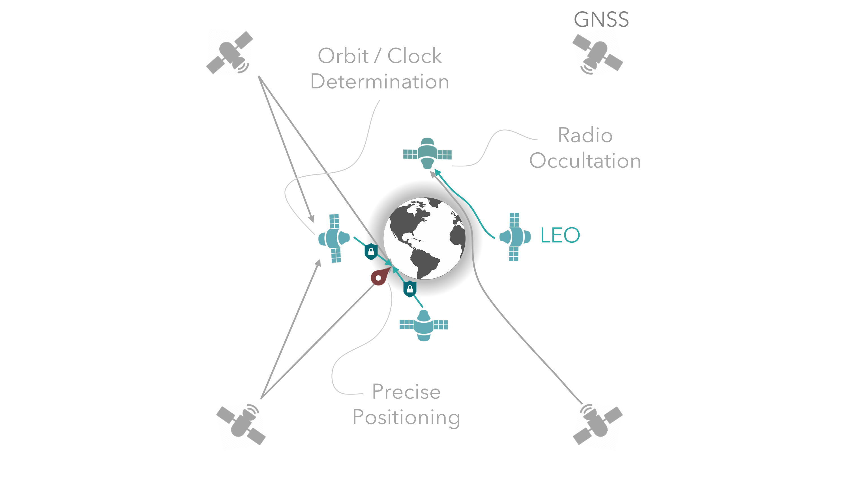
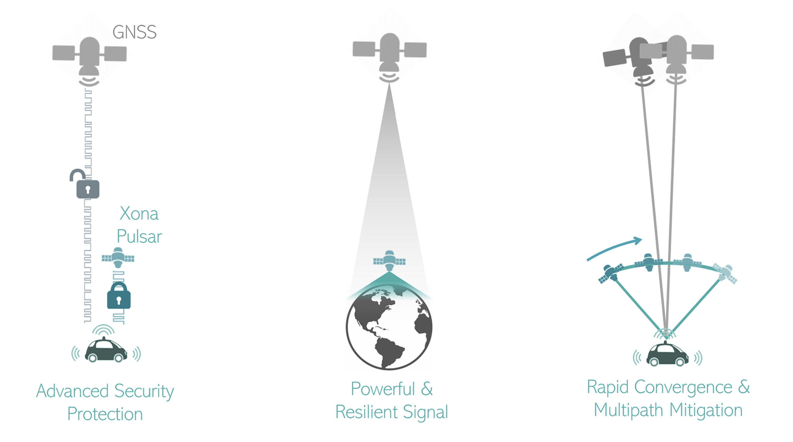
Outline
2
PNT Needs
Aerospace Ecosystem
Sat Nav Architecture for Today
Commercial LEO PNT
Notes:
This presentation has been broken down into four segments,
First, is what are the user requirements. What should we be striving towards in terms of performance to meet the user needs on the horizon
Next is a look at the aerospace ecosystem, where in especially the last 5 years a lot has happened that really challenges many prior assumptions of what can be done in space
With the requirements and technology ecosystem, how would you build a satellite navigation system today that meets those requirements and best leverages that ecosystem, particularly with a focus on commercial and civil users
And last I’d like to speak about our company, Xona Space Systems, and our vision for commercial satellite navigation to support autonomy

Slide 3
Outline
3
PNT Needs
Aerospace Ecosystem
Sat Nav Architecture for Today
Commercial LEO PNT
Notes:
To answer this, this presentation has been broken down into four segments,
First, is what are the user requirements. What should we be striving towards in terms of performance to meet the user needs on the horizon
Next is a look at the aerospace ecosystem, where in especially the last 5 years a lot has happened that really challenges many prior assumptions of what can be done in space
With the requirements and technology ecosystem, how would you build a satellite navigation system today that meets those requirements and best leverages that ecosystem, particularly with a focus on commercial and civil users
And last I’d like to speak about our company, Xona Space Systems, and our vision for commercial satellite navigation to support autonomy

Slide 4

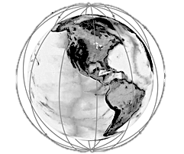
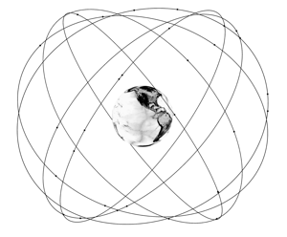

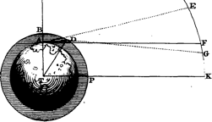
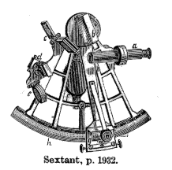
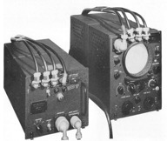
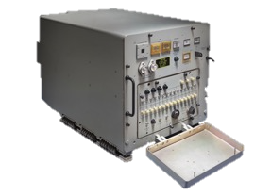

A Brief History of Navigation
4
Celestial/Chrono
1770-1920
3000 m
(5 sec)
Loran
1940s-2010
460 m
(100 μs)
Transit
1964-1996
25 m
(10 μs)
GPS
1996-Present
3 m
(10 ns)
?
2025+
<0.30 m
(< 1 ns)
Notes:
Very much from a positioning point of view but I have also indicated the timing requirement as part of these systems
Historically, new technologies and modes of transportation brought new Position, Navigation, and Time challenges, resulting in many technologies to support them.
One hundred years ago, Maritime made use of celestial navigation, giving km’s of position accuracy, but as many of you know, longitude was famously solve by Harrison with precision mechanical clocks needing seconds to get that level of east west accuracy
30 years later, in WWII, we see the advent of Radio Navigation to support aviation, giving 100’s of meters of accuracy, loran was also showed capable of supporting 100 ns time transfer in certain conditions over land
30 years later, we see satellite navigation to support the cold war, this relied on doppler shift observation and hence absolute time was not as critical in positioning but nonetheless was known capable of 10 microsecond time transfer
And now, we all enjoy meter level location thanks to GNSS which of course is at the 10 ns level
The question is: What’s next?
The reason for choosing 30 cm is that it is the natural progression in positioning and the corresponding time accuracy (scaled by the speed of light) is better than 1 ns.

Slide 5
‘Moore’s’ Law of Navigation
5
Trend:
10x better accuracy
every
30 years
2020s:
Decade
of the Decimeter
Notes:
If you plot this there emerges a Moore’s law of navigation
We see that every 30 years, there is a 10x improvement in largely available location accuracy
It also suggests that every 30 years there is investment in new infrastructure that was driven by a need and as we saw timing really follows suite. More information to be moved around more quickly means tighter and tighter timing requirements.
What is that need today in terms of navigation? (next slide)

Slide 6
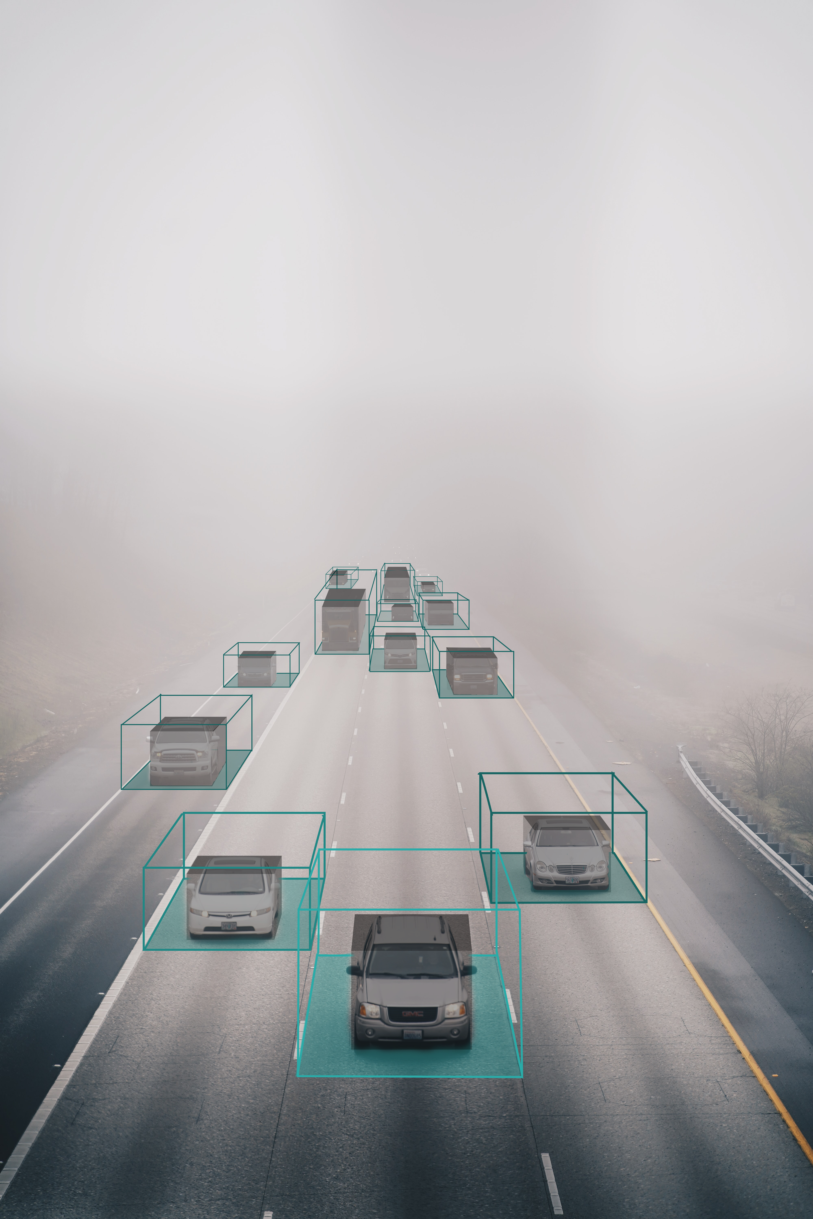
New Nav Drivers
6
Autonomous Driving needs
10 cm, 95% (2σ)
30 cm, 10⁻⁹ (5.7σ)
Notes:
In my view this intelligent transportation systems which are pushing for decimeter or better performance
Satellite navigation holds a lot of potential as a ubiquitous solution to support all forms of autonomy, whether it be land, sea, or air
An important aspect is a common reference both for position and for time. As these systems ultimately work together to achieve the highest benefit, they must share a common reference to interoperate.
Satellite navigation offers that common vantage point at this world scale
There are no official standard out there yet for localization requirements, but Work from Ford Motor Company indicates that 10cm, 95% accuracy is what’s needed for full self-driving
The hard part is the requirements for safety.
This is still developing, but the thinking here is that location needs to be known to the 30 cm level at the strictest standard in automotive, which is essentially a 6-sigma number in terms of reliability.
Decimeter positioning is needed to maintain the vehicle in its lane, but timing is critically important not just for sensor fusion onboard the vehicle but also for information sharing. Milliseconds are centimeters at highway speeds, for example.

Slide 7











WHO IS ASKING FOR WHAT IN 2022+
7
Infrastructure / Timing users: Better security, resilience & indoor penetration
Correction-service users: Higher accuracy & faster convergence
DoD Users: Improved anti-jam performance and system redundancy
IoT / mobile users: Better multipath resistance & lower receiver power
Automotive Autonomy users:
All of the above
Aerospace
Drones & Robotics
IoT & Asset Tracking
Weather Data
Government & Defense
Auto & Trucking
Mobile
Infrastructure
Cell Towers
Farming
Power & Finance
Notes:
But what about the other user groups, which combined number in the billions…
Timing and infrastructure users seek improved security, resilience, and indoor capability
High accuracy position users want higher accuracy and to get that accuracy faster in the form of convergence time
DoD users want improved anti-jam / anti-spoof capability
IoT users looking for better multipath performance, indoor capability, and lower receiver power required
And automotive users want all of the above, and generally by having this as our target we meet the targets of these other user groups as well

Slide 8
Outline
8
PNT Needs
Aerospace Ecosystem
Sat Nav Architecture for Today
Commercial LEO PNT
Notes:
This sets the stage in terms of the need, how do we get there? I’d like to take a look at what is going on in the aerospace industry to understand its direction well.

Slide 9
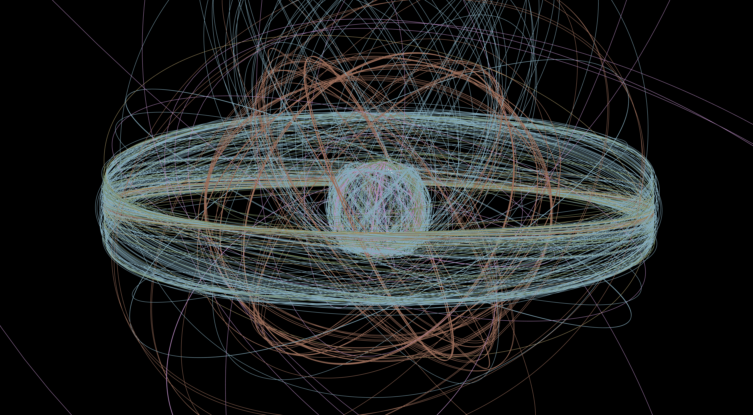
Strength through diversity
9
Notes:
Let’s start with a look of what’s in orbit. This plot represents all of the operational satellites in orbit in 2016

Slide 10
Strength through diversity
96
37
HEO
Strength through diversity
MEO
506
GEO
780
LEO
Total Operational Satellites
Nov 2016: 1419
Notes:
In 2016, this was just over 1400
You can see some groups, where about half were in GEO, half in LEO, and about 100 in MEO which represents the navigation satellites

Slide 11
Strength through diversity
96
141
37
59
HEO
Strength through diversity
MEO
506
574
GEO
780
4078
LEO
Total Operational Satellites
Nov 2016: 1419
Jan 2022: 4582
Notes:
Fast forward to today and a lot has changed, particularly in LEO.
First off, there are more than 3x the number of operational satellites compared to 5 years ago
We of course see growth in MEO, that represents completion of BeiDou and Galileo
But the big one is LEO where we see nearly 5x as many satellites as compared to 5 years ago

Slide 12
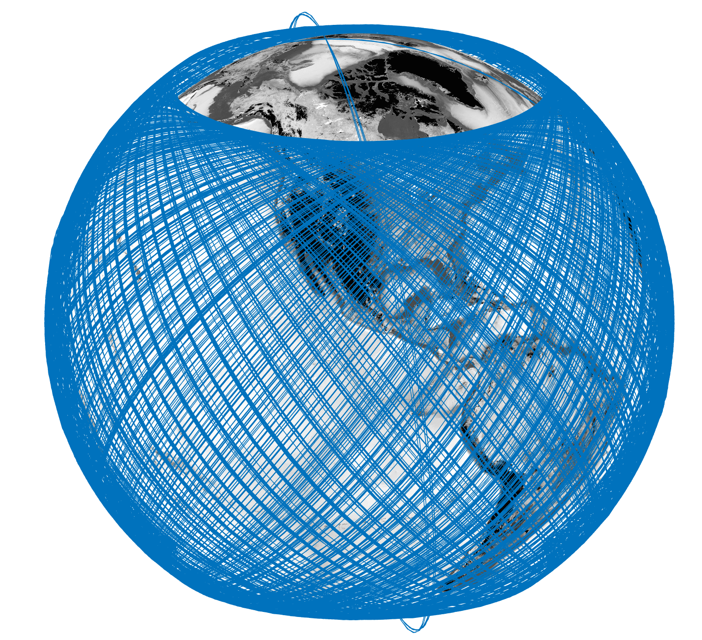

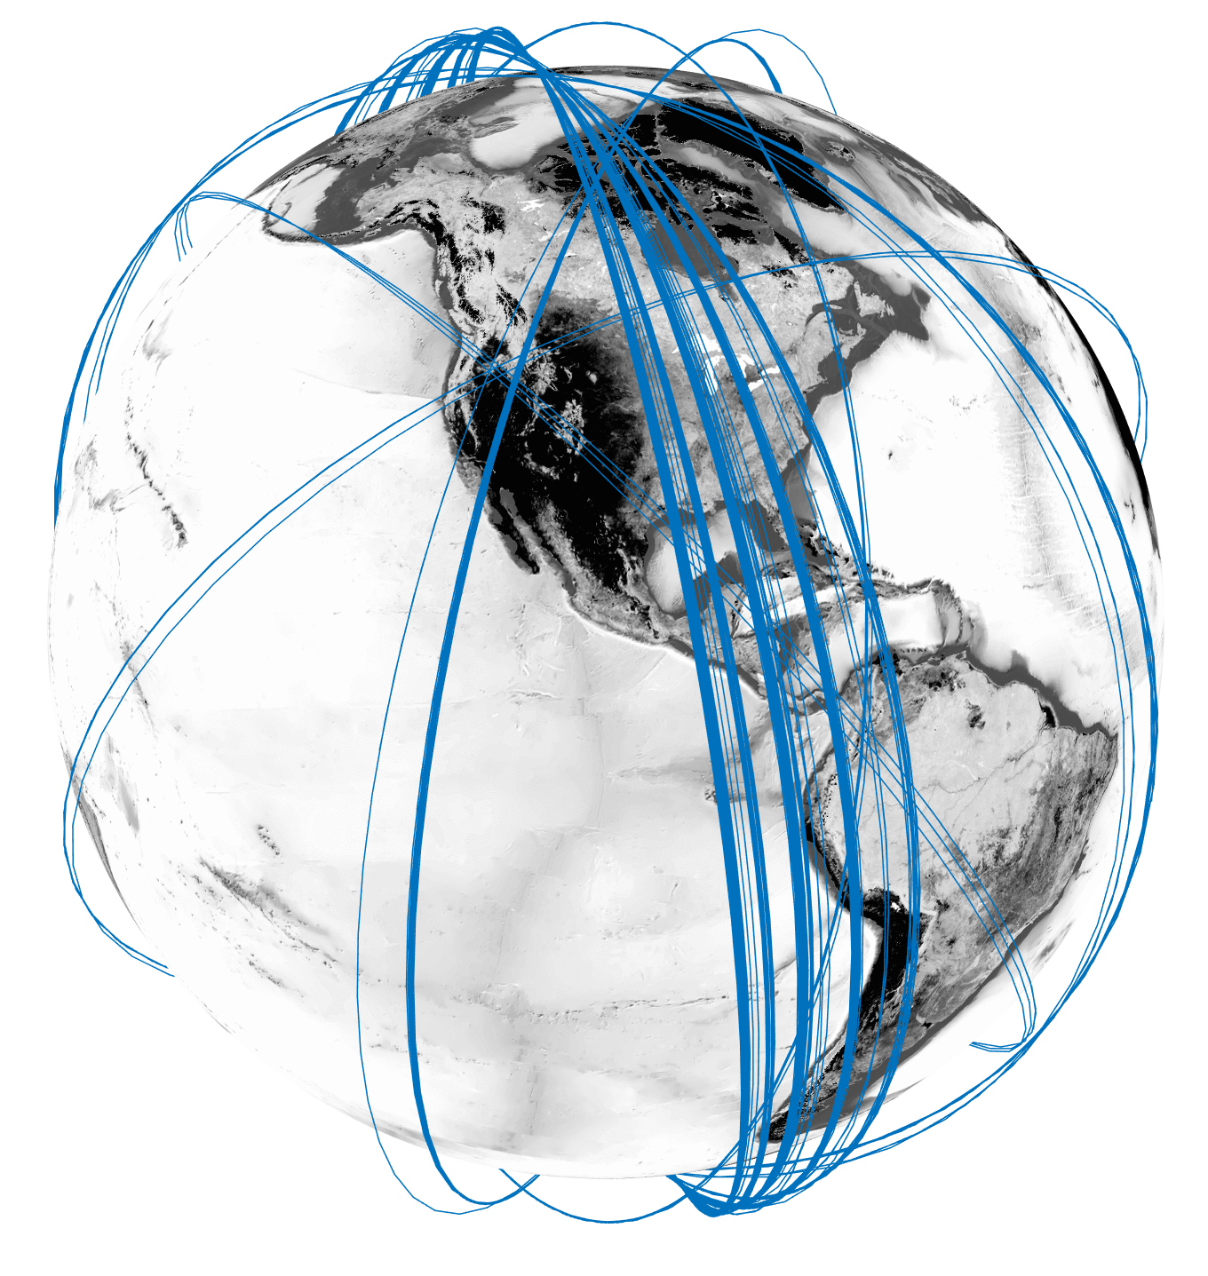
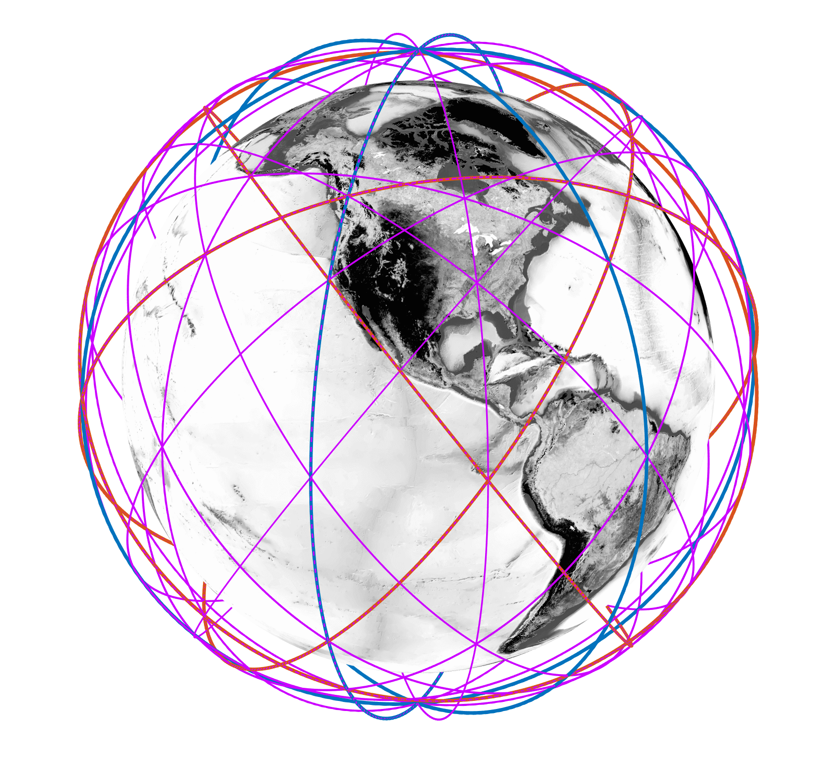

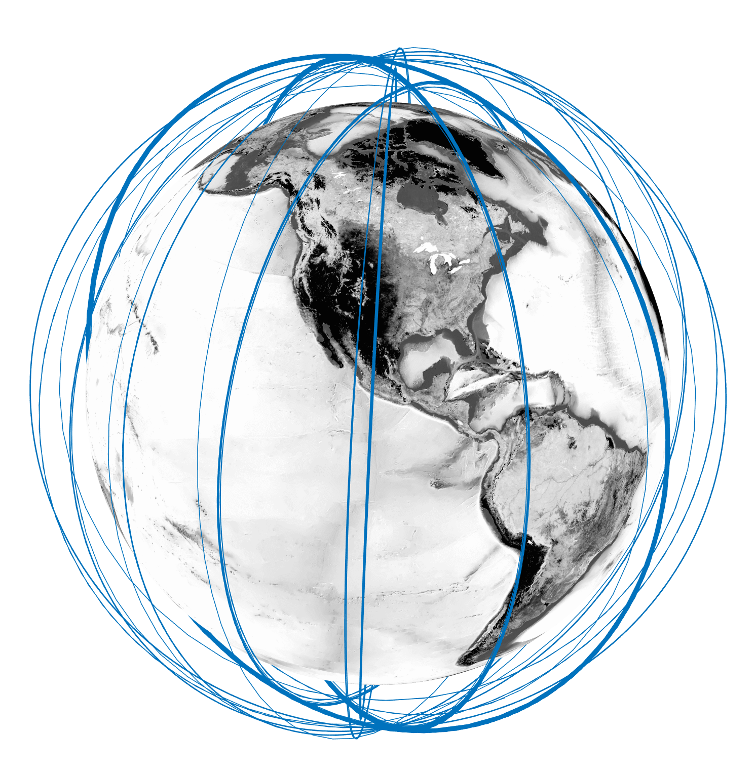




LEO Mega-Constellations
12
Broadband
Remote Sensing
Position, Navigation,
& Time
#Sats = 2077
#Sats = 218
#Sats = 426
#Sats = 113
#Sats ~ 300
(Planned)
Notes:
What are the motivations for this? Well there are many, but one is an increased demand for geospatial data and the other is an increased demand for connectivity.
In connectivity, SpaceX, OneWeb, and others are all building constellations of thousands or tens of thousands of satellites to provide global broadband.
SpaceX has more Starlink satellites than there were total operational satellites just 5 years ago
Starlink launches as many as 60 satellites at a time and they are not small, they are 400 kg satellites. This is almost the size of the entire iridium constellation
In geospatial data, commercial LEO Earth observation constellations from the likes of Planet and Spire are providing a better geospatial view of our planet
These are the so-called mega constellations and they represent the new space economy enabled by lower launch costs and new satellite production techniques.
Things move so quickly in this domain that even though these numbers are only a few weeks old, they are probably out of date, so apologies for that
Commercial communications and Earth observation have seen disruption with this space infrastructure but not yet navigation. At Xona, we are working on leveraging these conditions to provide new capability in this domain.
And this is where I would like to expand
Into how might you architect a satellite navigation system today given this ecosystem
Mention LEO PNT already from LEO comms

Slide 13
ARCHITECTURE
13
PNT Needs
Aerospace Ecosystem
Sat Nav Architecture for Today
Commercial LEO PNT
Notes:
Into how might you architect a satellite navigation system today given this ecosystem

Slide 14
A Comparison of Requirements
14
 | GPS | Sat PNT for Today
Focus User Group | Government | Commercial
Accuracy | 5 bombs in the same hole | Keep self-driving cars in their lane
Availability | Global | Global, Enhanced in population centers, Indoor penetration
Resistance to Interference | State-level actor | Unintentional & PPD’s
Cost-Effective Space / Ground Segment | Government | Commercially viable
Affordable User Equipment | Portable | Mass market
Notes:
To give some motivation, I’d like to focus on a few requirements and few differences than the approach typically taken in GNSS where I will use GPS as and example because it was first architected in the 1970s aerospace ecosystem.
This not an extensive list but something to highlight some differences
First is the user group, in this thought experiment we will focus on commercial users vs government. Which by the way commercial users represent more than 99% of GNSS users.
Next is accuracy, GPS was designed to drop 5 bombs in the same hole, today commercial users want to keep the car in their lane
Availability, both want global performance, but commercial users are more focused on population centres.
Interference, both are concerned, but one with state-level actors and the other with smaller personal privacy devices
Cost effectiveness means different things to commercial and government entities
And user equipment, where one is targeted at mass market applications.

Slide 15
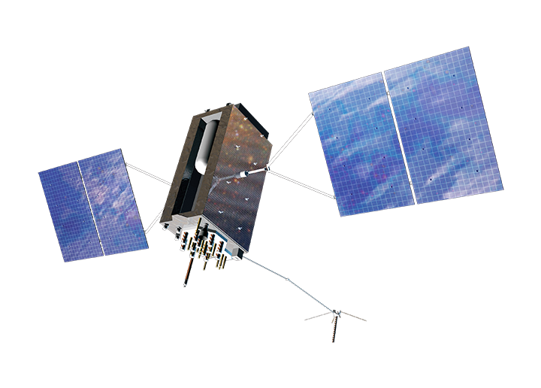





GPS Architecture
15
MEO
Rad Hard
Atomic Clock
Rad hard satellite with atomic clocks are expensive.
MEO wins over LEO due to 10x less satellites needed while still satisfying daily upload constraint.
CDMA
Govt grade TT&C
10 m, RMS (~100-15ns TE)
Notes:
So what orbit to you chose? The trade off was, the satellites had to be radiation hardened, had to have atomic clocks, had to be built in the 1970s and 80s, and the result was that MEO won over LEO. The reason was that the satellites were going to cost about the same and you needed 10x less satellites in MEO so launch cost won over build cost.
This very much the model that has been followed since GPS and why in many ways the other government GNSS constellations look similar.

Slide 16

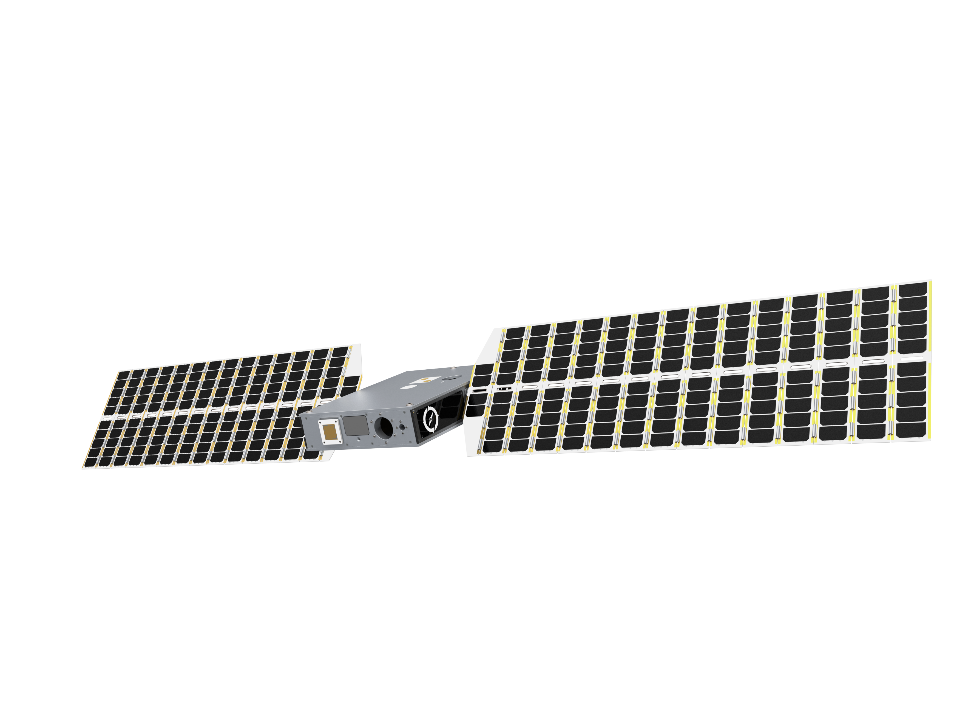



High received power
Fast geometry change for multipath mitigation
Low cost
NEXT GEN Sat Nav
16
Move to LEO
Rad Tol
LEO
Low SWaP Clock
Commercial TT&C
5 cm, RMS (~10-1ns TE)
Atomic Clock
Notes:
So the result is a commercial satellite navigation constellation in LEO with low-cost satellites produced in volume with largely off the shelf space-capable components.
Something I want to make clear in that last comment, this is not to say you replace space-grade components with mass market ones, just that the megaconstellations ecosystem has resulted in a healthy space-capable component supply chain

Slide 17
Outline
17
PNT Needs
Aerospace Ecosystem
Sat Nav Architecture for Today
Commercial LEO PNT
Notes:
This new space approach to satellite navigation is very much is the mindset we have taken at Xona

Slide 18


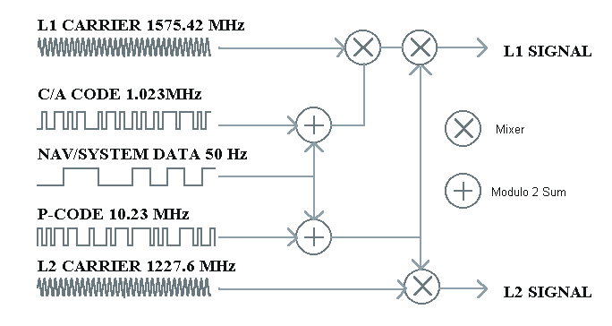








Commercial LEO PNT
18
GNSS
LEO
Geometry Change For Precision
Encryption & Authentication
Stronger
Signals
Notes:
A commercial LEO navigation system has the opportunity to provide several enhancements to GNSS today, the first is:
Precision – PPP-RTK
The fast motion across the sky (the quick geometry change) gives much in the way of rapid convergence for precise point position as well favorable characteristics for multipath, because those signals are not as static over short timescales
Availability/Resilience – stronger signals / more of them
Being closer to Earth we have the opportunity for stronger signals strengthening us to interference, and
Security
New LEO signals aren’t bound by legacy, so there can be inclusion of encryption and data authentication. This is not only detection of spoofing signals which then often defaults receivers to holdover mode if it is detected, but it is protection to work through it and not lose service as well.
A commercial LEO layer can add capability that can evolve quickly, on a 5 year timescale, to keep up with the pace of demand. Much more difficult to do this with legacy GNSS services because they are already supporting billions of devices and hence a big inertia to large changes.
Comment from Jaime – explain how this leads to better timing service / reference.

Slide 19

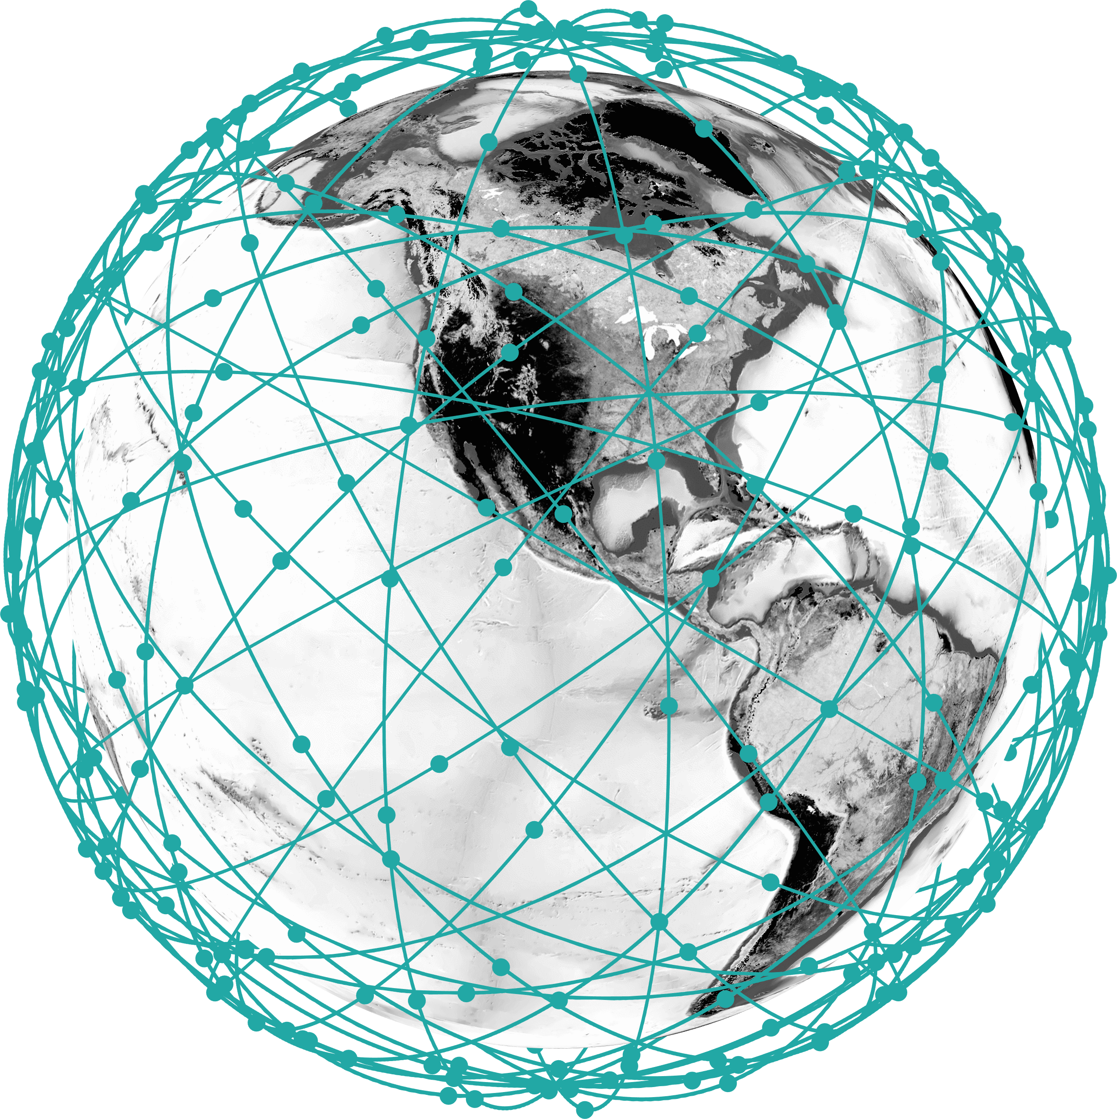


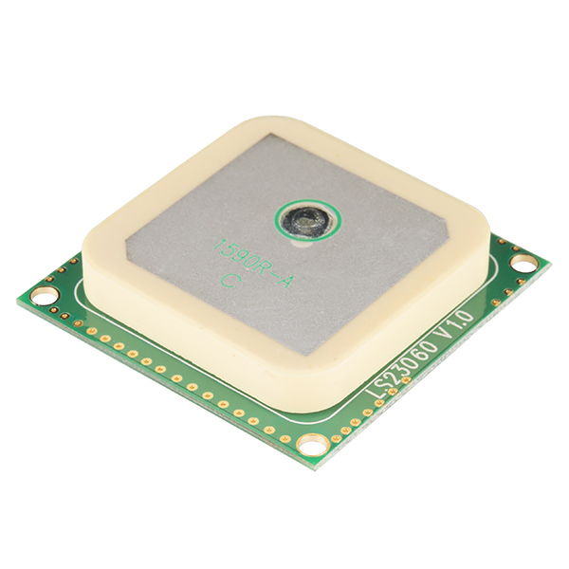

Navigation & Timing as a Service
19
Commercial satellite infrastructure…
…work with receiver manufacturers to integrate functionality…
…to provide enhanced services that are easily deployed to end users.
Notes:
What does this look like as a business. There is already a very large market established where companies subscribe for higher performance GPS from the correction service providers. Our business model is very similar where we are building and operating the infrastructure, working with chipset and receiver manufacturers to integrate our capability into their devices, to offer a service to the end user on a subscription model.

Slide 20
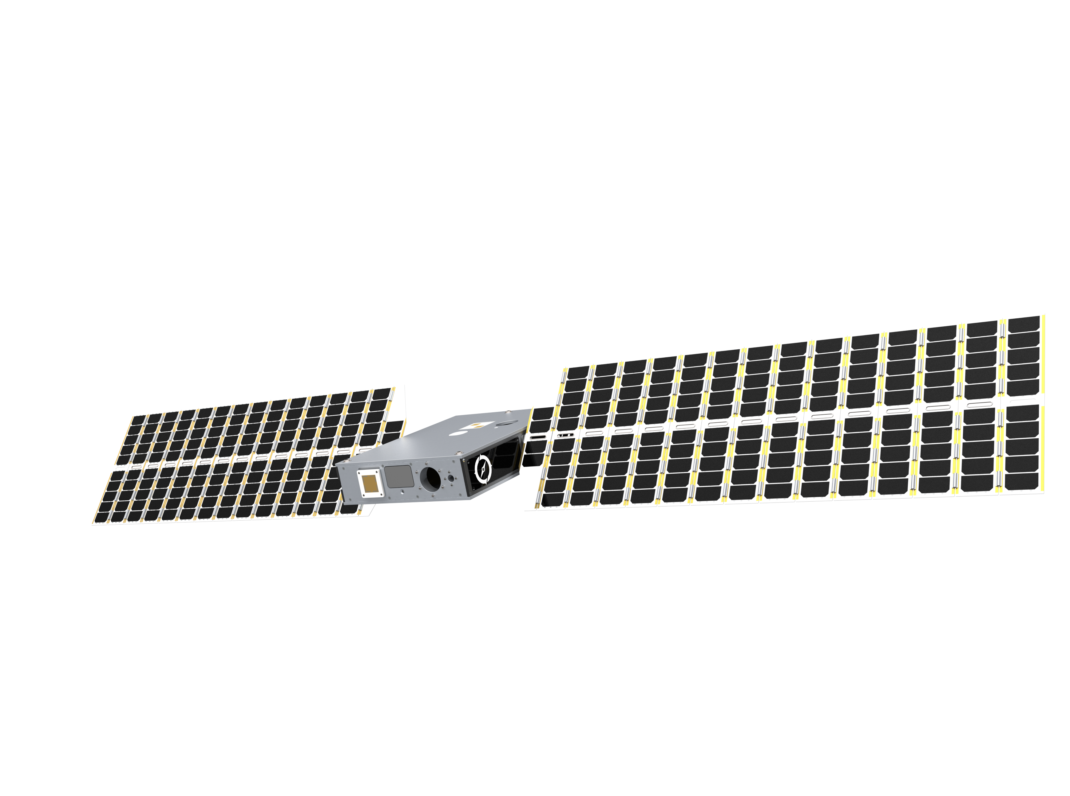

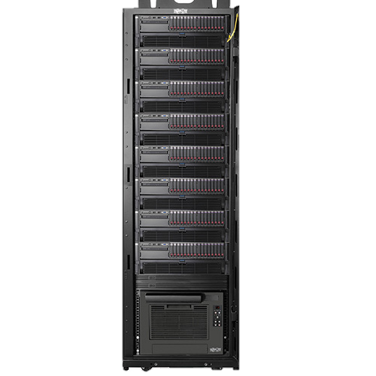
TIME INDOORS
20
GNSS
LEO
Powerful signal can penetrate several walls, enabling indoor antenna deployment
Simplified installation
Remove need for roof access, rent, etc.
Eliminates outdoor antenna installation & maintenance costs
Large constellation = high probability of at least intermittent reception
Notes:
Last but not least in indoor signal penetration
This can simplify installation and deployment as well as just the barrier to entry
Remove need for roof access, rent, running the cables
Eliminates outdoor antenna installation & maintenance costs
Large constellation = high probability of at least intermittent reception
Even with daily / hourly Pulsar connection + TAP clock, output still meets spec
Mention this brings time transfer to the rack rather than to a single point in a data center. This is already fielded today.

Slide 21

Phased Rollout
21
Phase 1
Phase 2
Phase 3
Timing Users Corrections for Dynamic Users | >99% Availability Mid-Latitudes | >99% Global 100% Mid Lat | 100% Global Coverage
Dynamic Users | - | >50% Global Coverage | 100% Global Coverage
Notes:
Building such a system doesn’t happen over night. We have a staged roll out plan with different levels of service planned along the way.
Phase 1 is a deployment of 36 satellites which offers a 1-in-view GNSS enhancement service over population centers.
In addition to GNSS correction services this also brings an additional ranging signal that is resilient and secure
Furthermore this brings time transfer for stationary users which can support critical infrastructure. On that last point we have an engagement with NIST to evaluate the time transfer capability of our demonstration satellites in a cooperative research agreement where our first satellite is slated for launch in June of this year, so within six months
Phase 2 is 66 satellites which offers the same service as Phase 1 but now globally
This fills with more satellites over both poles and equator and also brings more satellites in view over mid latitudes
These are all stepping stones towards Phase 3 which is 276 satellites, and this gives global GPS-level satellite visibility and geometry and full PNT services that are precise and secure.

Slide 22
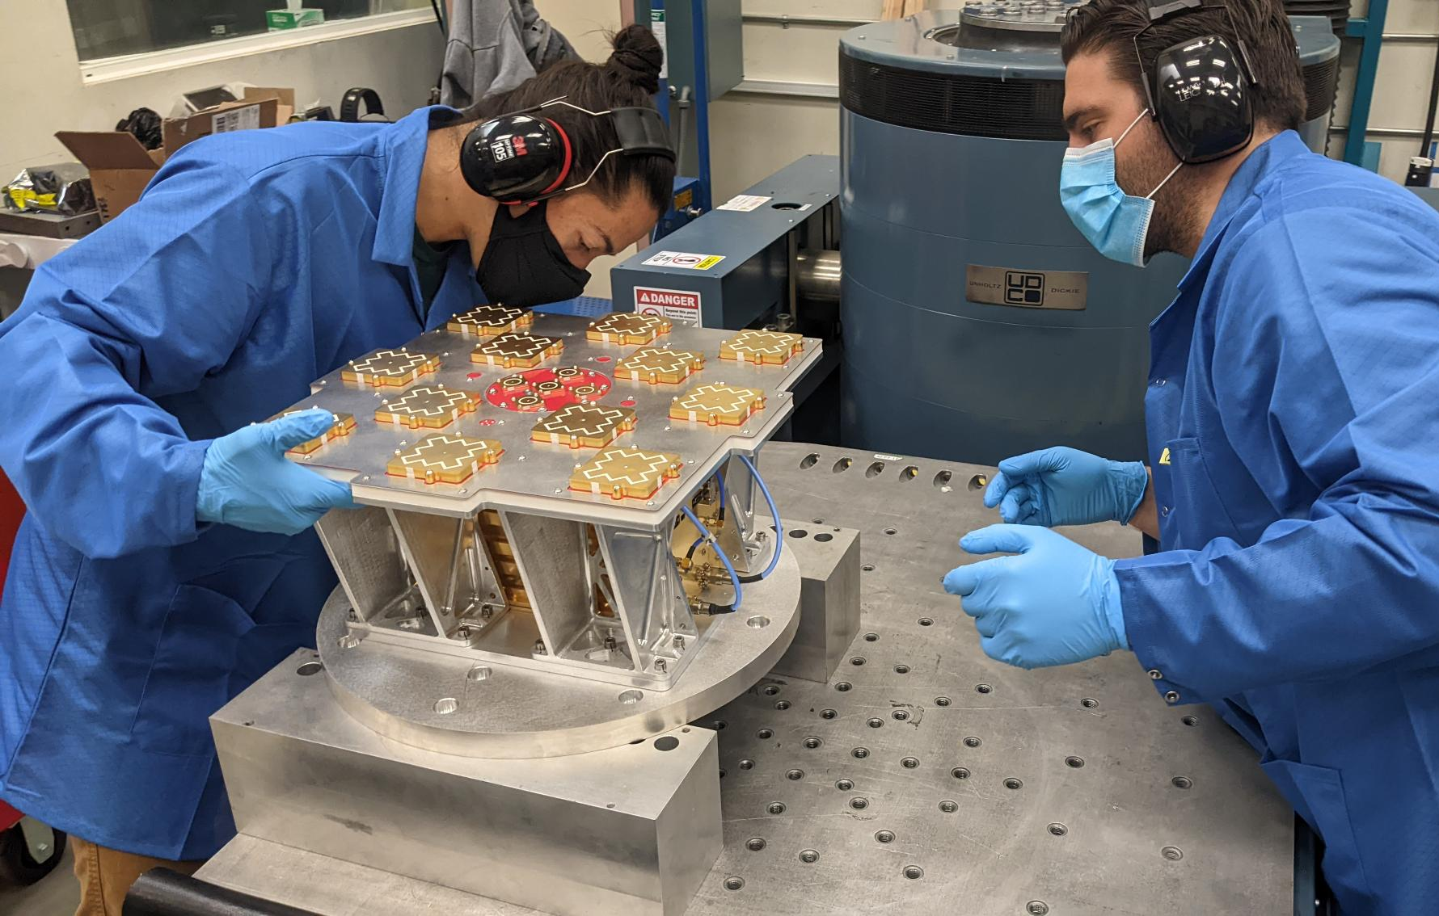
DEDICATED LEO PNT DEMO
22
Xona is launching its first LEO PNT demo spacecraft this month.
Broadcast experimental PNT signals from LEO.
Interface Control Document is available to interested parties.
Notes:
But the first step in all of this is to launch our demonstration satellites, where the first is scheduled for launch in June of this year
To support this effort, we’ve been fortunate to have great partners and investors such as those listed here
These satellites will allow us to test major aspects of the system, including software reprogrammability on orbit, and primary goal is to show that such a payload suitable for a LEO small satellite can generate signals of high quality for navigation

Slide 23
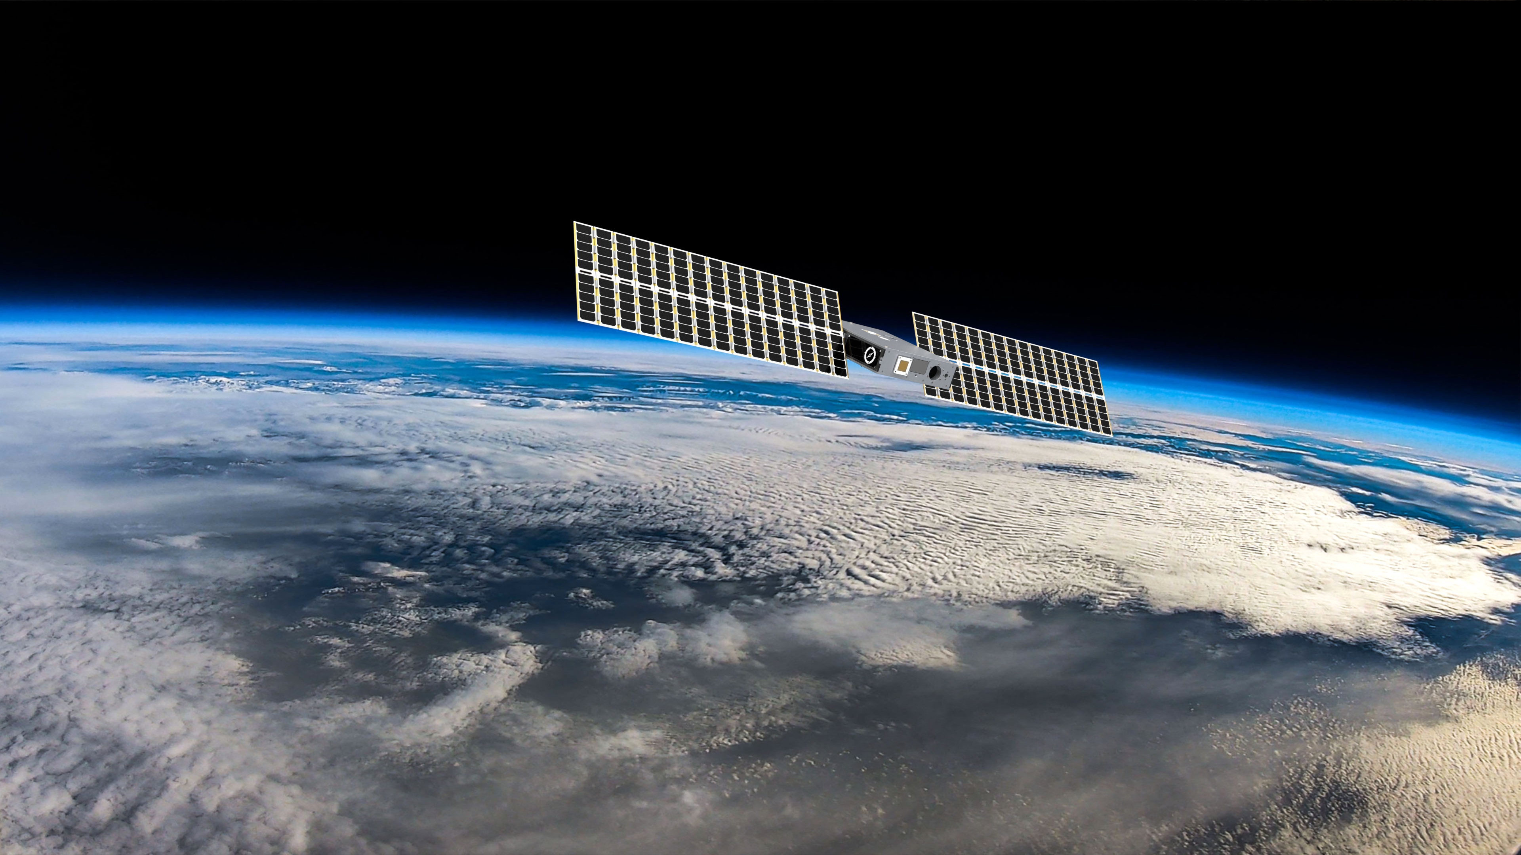
23
THANK YOU
Jaime Jaramillo | Jaime@xonaspace.com
Notes:
Thank you very much for your attention, and thank you again to the organizers for the invitation
I would be happy to take any question here today but please do feel free to reach out to my email which listed here
Thank you

